Slide 1
Annual General Meeting 2023
Capricorn Energy PLC
26 June 2023

Slide 2


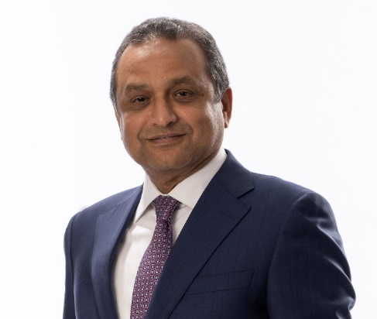





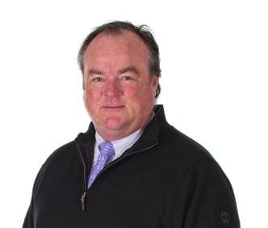
Capricorn Board
2023 AGM
[INSERT RANDY HEADSHOT]
Craig van der Laan
Independent
Non-Executive Chair
Randy Neely
Chief Executive
Hesham Mekawi
Independent Non -
Executive Deputy Chairman
Maria Gordon
Independent
Non-Executive Director
Richard Herbert
Senior Independent Director
Tom Pitts
Independent
Non-Executive Director
Patrice E. Merrin **
Independent
Non-Executive Director
Catherine Krajicek *
Independent
Non-Executive Director
Erik B. Daugbjerg *
Independent
Non-Executive Director
* Catherine Krajicek and Erik B. Daugbjerg will retire from the Board at the Capricorn 2023 AGM
** Subject to election at the 2023 AGM

Slide 3

Introduction from the Chief Executive
2023 AGM
  Randy Neely joined Capricorn on 1 June 2023
    Previously President and CEO of TransGlobe Energy Corporation; a very successful low cost, Egypt-focused business, including assets in the Western Desert
    Highly experienced industry leader, delivering high-performing operations in Egypt
    Background of successful strategic execution, knowledge of host country and a track record of effectively managing relationships to deliver results
    Randy led negotiations which resulted in an amended, extended and consolidated Production Sharing Contract with EGPC in Egypt
    Creating shareholder value; leading merger between TransGlobe and VAALCO Energy

Slide 4
Reminder of Strategic Review
2023 AGM
Significant
Cost Reduction
Refocused
Exploration Strategy
Maximising Shareholder Value from Egypt
Driving Culture Change
    Material G&A reduction: matching organisation
    to activity set
    Focus on short-cycle, rapid payback Egypt exploration
    Monetise, farm-down and exit exploration outside Egypt
    Developing long term plan to grow value
    Further details at Q4 2023 Capital Markets Day
    Focusing on shareholder value
    Cost consciousness and transparency
Shareholder Returns
    Detailed examination of capital framework
      Provide immediate return of value to shareholders
      Position for ongoing returns
      Efficient funding of core business to maximise value
Immediate cash return US$450m
special dividend paid in May 2023
US$100m special dividend in Q4 2023 – subject to various factors*
Share buyback programme of at least US$25m
over next 12 months
Targeting ~US$575m return of capital over next 12 months
All additional excess capital to be returned by special dividend or buybacks
* | The US$100m special dividend in Q4 2023 is dependent on a number of factors including: addressing our receivables position in Egypt; the outcome of conversations with stakeholders in Egypt around licence extensions and renegotiation of terms; actual oil and gas prices outcomes for the remainder of 2023; and the conclusions of our strategic review as it relates to further cost actions and future investment in the Egypt business

Slide 5
2023 Full Year Guidance
2023 AGM
Production
Overall Production (WI)* | 32,000 – 36,000 boepd
Oil & Condensate (WI)* | 14,000 – 16,000 boepd
Gas Production (WI)** | 100 – 112 mmscf/d
Opex
Full year opex guidance | ~US$5-7/boe
Capex
Egypt Development & Production Multiple rig programme in 2023 (drilling: 50-60% of total D&P capex) and Teen pilot project | US$100-$120m
Egypt Exploration Commitment wells targeted at sustaining the resource base over time | ~US$25m
International Exploration*** Including ~US$25m costs associated with Mexico including Yatzil well drilled Q1 2023: final international commitment well outside Egypt | Up to US$30m
* | Working interest reflects Capricorn’s equity interest in the licences before reduction of production share owed to the Egyptian Government
** | Sales gas is ~90% of WI volume with a 5.6 conversion factor from mmscf to boe
*** | Minimising exploration spend in 2023; no committed International exploration spend in 2024

Slide 6
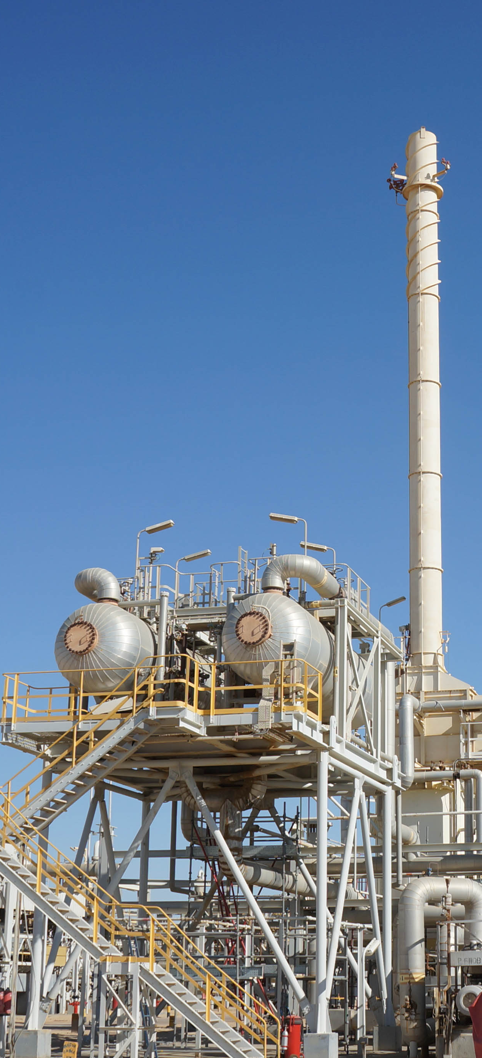
Initial observations
2023 AGM
    Company has been significantly impacted by turmoil of past year+
    Relationships and confidence need to be rebuilt with government, partners, staff and shareholders
    Confident this can be achieved through:
        Right-sizing / streamlining organisation
        Laser focus on revenue generating business
        Minimising distractions (exiting non-core businesses)
        Leverage asset platform, experience and skillset to add significant value to the Company
        Providing returns to shareholders

Slide 7
Strategic Review progress
2023 AGM
Action | Status
Return US$450m cash to shareholders; commenced share buyback programme of at least US$25m | Achieved
Exit Mauritania | Achieved
Potential UK Sales Process | Ongoing
Cost reduction | Ongoing
Address building Egypt receivables and restricted cash | Ongoing
Egypt license extensions and renegotiation of terms | Ongoing
Review of business plan for Egypt | Ongoing
US$100m special dividend (subject to certain factors) | Q4
Capital Markets Day | Q4

Slide 8
Annual General Meeting 2023
Capricorn Energy PLC
26 June 2023

Slide 9
AGM 2023
Resolutions
Capricorn Energy PLC
26 June 2023

Slide 10
AGM Resolutions
2023 AGM
No. | Resolution
1 | To receive the report and accounts for the year ended 31 December 2021.
2 | To approve the directors’ remuneration report contained in the report and accounts.
3 | To approve the directors’ remuneration policy contained in the report and accounts.
4 | To re-appoint PricewaterhouseCoopers LLP as auditor.
5 | To authorise the directors to determine the auditor’s remuneration.
6 – 12 | To elect/re-elect the directors.
13 | To authorise the Company to allot relevant securities.
14 – 15 | To disapply pre-emption rights on allotments of equity securities or treasury shares.*
16 | To authorise the Company to make market purchases of the ordinary share capital of the Company.*
17 | To authorise the Company to call a general meeting other than an Annual General Meeting on not less than 14 clear days notice.*
18 | To adopt new articles of association of the Company.*
*Special Resolutions (all other resolutions are Ordinary Resolutions)

Slide 11
Annual General Meeting 2023
Capricorn Energy PLC
26 June 2023

